Slide 1
Android Electro Cardio Monitor
Group 22
Jeffrey Frye - EE
Jonathan Gibson - EE
Michael Sun - CpE
Cheng-Chieh (Jay) Wang - EE
Sponsored by: CECS Alumni Chapter ($150)
Notes:
Jeff
We are Group 22 and our project is the Android Electro Cardio. I am Jeffrey Frye, I am Jonathan Gibson, I am Michael Sun, and I am Jay Wang.

Slide 2
Project Motivation
Medical professionals need a new strategy for recording the vital signals of their patients.
The results of an ECG are essential data that should be portable so the patient and family can be able to view the heart rate signals.
Mobile platform for the ECG system
Notes:
Jeff

Slide 3
Project Goals and Objectives
Heart Rate Simulator
Design and implement a heart rate simulator using previous patients’ records.
The Analog Front End Circuit
Filter out any interference and isolate the desired signal from the simulator to be amplified.
Electro Cardio App
Receive heart rate signal via Bluetooth and display on Android device.
Notes:
Jeff

Slide 4
Specifications
9 V Battery powered
Attenuate simulated signal to 1 mVpp
Amplify a 1 mVpp signal without saturating amplifier.
Oscillate signal between 0 - 5 V
Filter power interference (60 Hz)
Build bandpass filter from 0.05 - 150 Hz
Android device must support Bluetooth
Notes:
Jeff

Slide 5
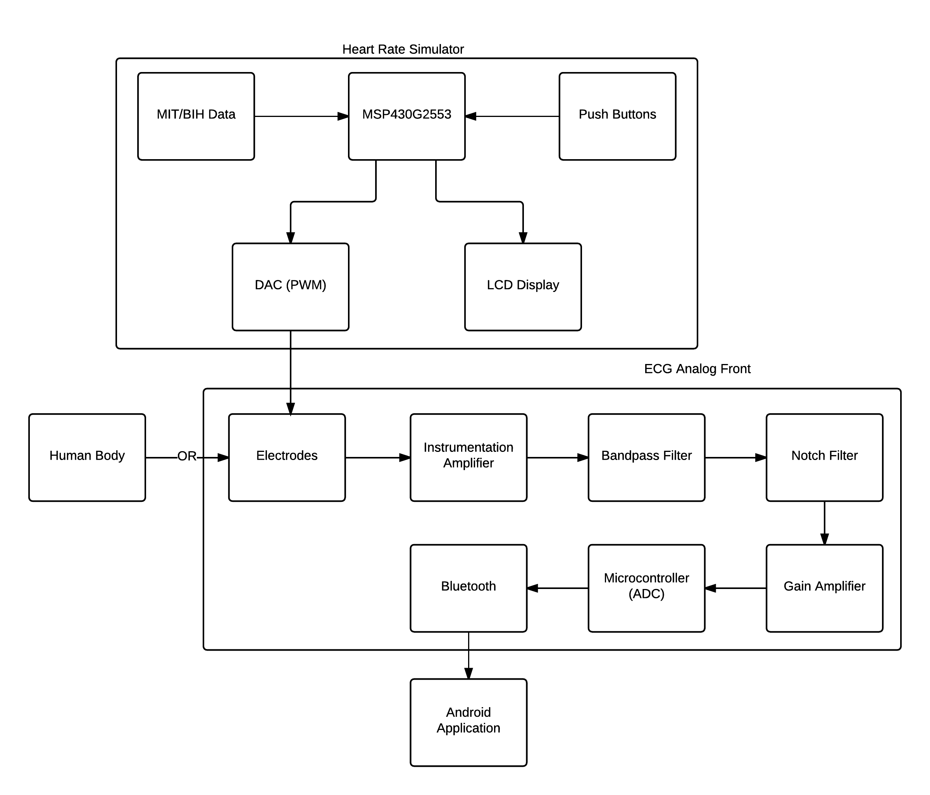
Overall Block Diagram
Notes:
Jeff This is the overall system block diagram. We will break it down into the individual subsystems and go into more depth.

Slide 6
Heart Rate Simulator
Simulate an actual heart signal
Read in data files from an online database
Output an authentic heart rate signal to the next subsystem to be read
Notes:
Jeff
The first subsystem of our electrocardiography reader is the Heart Rate Simulator. Since the heart rate signal needs to create realistic heart signals and real time signals from people cannot be used for safety reasons, the signals must be simulated. The goal for this subsystem is to read in data files from an online database and output an authentic heart rate signal. This heart rate signal will then be sent to the next subsystem to be read.

Slide 7
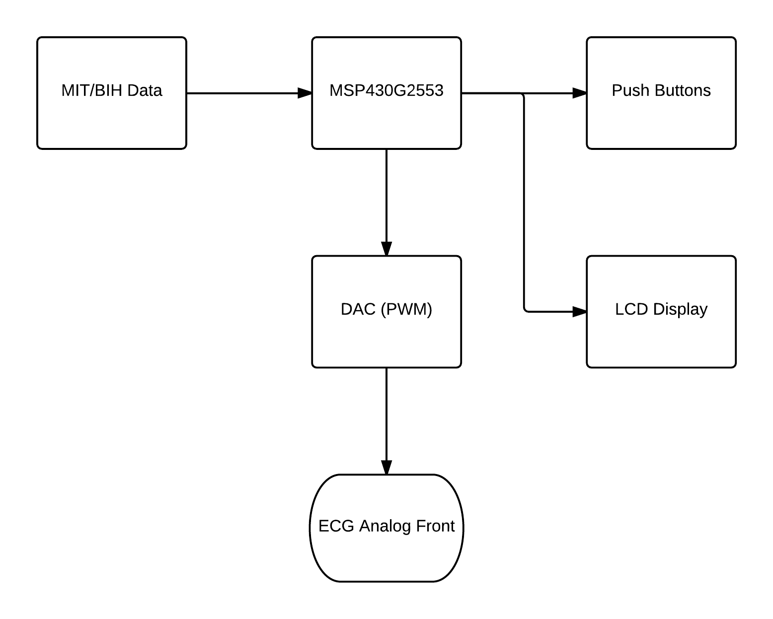
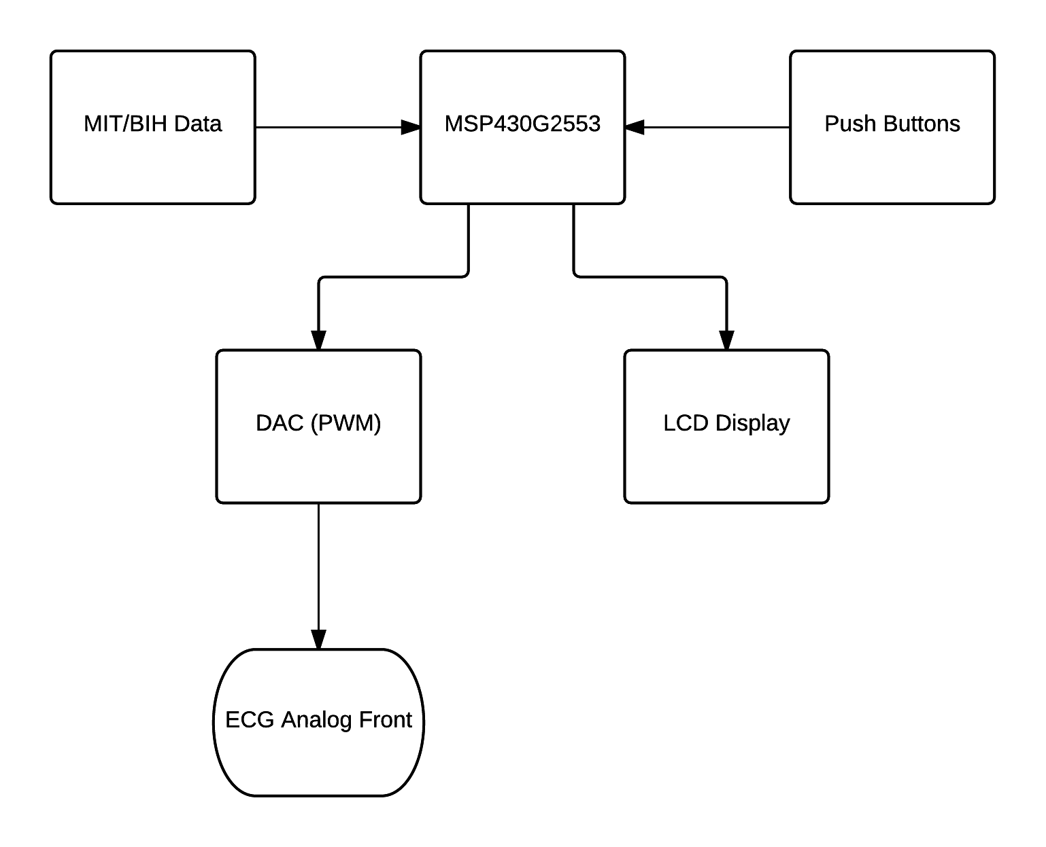
Block Diagram
Heart Rate Simulator
Notes:
Jeff
Here is the overall block diagram for the Heart Rate Simulator. I’ll start by discussing the MIT/BIH Data.

Slide 8
MIT/BIH Data
PhysioBank - online source with various different databases all available for free.
Data can be viewed as a text document for our use.
Three signals chosen from:
Normal Sinus Rhythm, Arrhythmia, and QT Databases
Notes:
Jeff
PhysioBank is an online source with several databases mainly developed at MIT and have been made available to the research community. We can choose a record and a time frame to view and can see the electrocardiogram and output the signal as a text document to show the time and voltage at each interval. The three signals we are using for the simulator are from the Normal Sinus Rhythm, Arrhythmia, and QT Databases. The last two signals are slower and more irregular since we wanted to test not a normal person’s signal. These have the QT interval with the humps much higher than that of a normal signal and will be fairly obvious when they are shown during the demo.

Slide 9
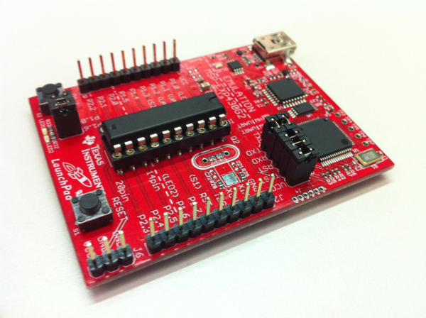
Microcontroller
MSP430G2553, used in Launchpad
CPU speed | Up to 16 MHz
Flash Memory | 16 KB
Analog to Digital Converter (ADC) | 8 channel, 10-bit
Random Access Memory (RAM) | 512 B
Communication | Up to 1 I2C, 2 SPI, 1 UART
Pins | 20 pins
Timers | 2 16-bit Timers
Notes:
Jeff
The chosen microcontroller must have enough pins to be able to communicate with push buttons and a 16x2 LCD screen and any external memory. So with this microcontroller having 20 pins, that is enough for our project. Since we are going to be testing several different signals, with more than 300 data points per second, none of the microcontrollers we looked at had enough memory so we did not really put the memory space as a major factor when picking a microcontroller. All members in our group have already had experience programming the launchpad in our embedded systems class and are familiar with Code Composer Studio. Using the Launchpad makes it much easier to code and test this subsystem of our project. Once the microprocessor is on the PCB, it’s very simple to load and test a new program.

Slide 10
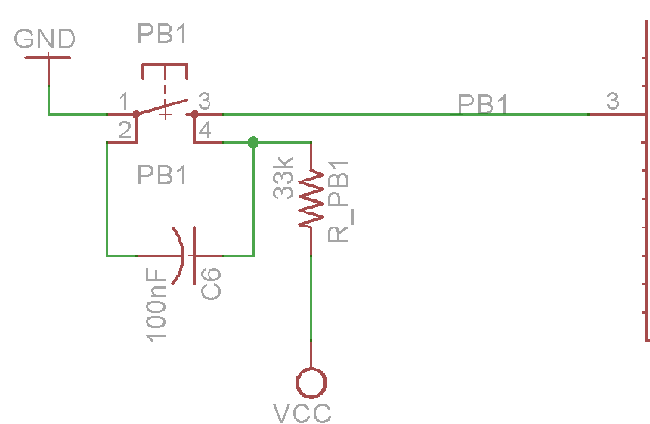
Push Buttons
Simple pull-up configuration
Simple circuit for debouncing
Using time constant of 3.3ms
Notes:
Jeff
Since in the end, we won’t actually be using the entire Launchpad, we have to connect external push buttons that will be used for the simulator. So we are using a simple pull-up configuration for the switches. We combated the bouncing of the switch by adding a capacitor. Using the equation for an RC circuit, our time constant is about 3.3ms. The capacitor is considered charged after about 17ms. When the button is pressed and the switch is closed, the voltage across the capacitor is discharged through the switch to ground. Since there is little resistance, this happens quickly. When the switch is released and open, the capacitor is charged via the 33k resistor and should take about 17ms to charge back up to the supply voltage. Any spikes from bouncing contacts are absorbed by the RC circuit.
Initially, we intended on having one button scroll down the list, while a second button would actually tell the microprocessor to send the signal. But, we were basically running out of available interrupts and timers that we could use for this second button to function reliably. So instead, a signal is always being sent, just when the main button is pressed, it switches to the next signal.

Slide 11
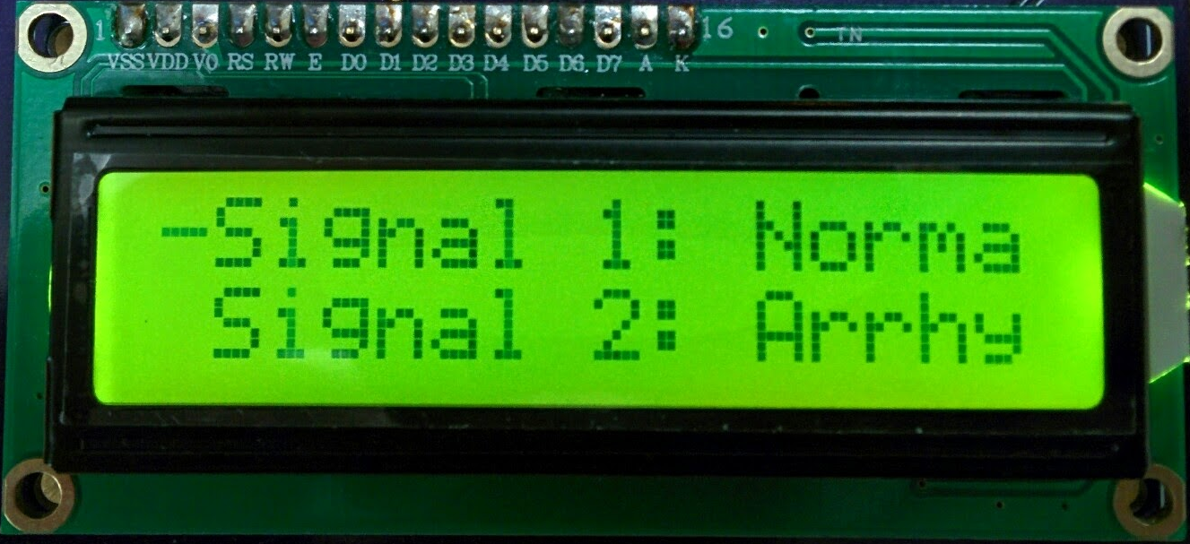
LCD Screen
Allow user to scroll through options using external push buttons and select which heart rate test signal to send.
3.3 V
16x2 characters
Send data in 4-bit mode
Notes:
Jeff
The LCD screen will serve the purpose of allowing the user to see the names of the various heart rate signals available to send from the simulator. The topmost signal will be scrolling so the user can view the entire label, and it’ll have a dash next to it. By pressing the push button, the user can change what’s on the display so the 2nd and 3rd signal labels are visible. Then, the signal will be sent through the rest of the system. The one we picked out is a 16x2 character LCD from Ebay and can run off of 3.3 volts. Using a microcontroller with limited pins, we can reduce the amount of pins required to communicate with the LCD from 11 to 7 if we use 4 bit mode. In 4 bit mode, we first send the upper four bits and then the lower four bits. This enables us to send 8 bit data by using 4 pins instead of 8. The interfacing of the LCD screen with the microcontroller is pretty simple.

Slide 12
Pulse Width Modulation
We use pulse width modulation (PWM) to act as a DAC.
The PWM signal outputs are variable duty cycle square waves with 3.3V amplitude.
Realizing D/A output from a PWM signal - analog low pass filter the PWM output to remove most of the high frequency components, leaving the DC component.
Notes:
Jeff
To output an analog heart rate signal using the individual signal’s data from the online database, we had to think of a method since this MSP430 did not have a digital to analog converter on board. We decided to use pulse width modulation as an alternative to a DAC. The MSP430 outputs the PWM signal, which are variable duty cycle square-waves with 3.3V amplitude. The resolution will be just 8 bits, giving 2^8 = 256 possible PWM widths. To realize the analog signal, we pass the signal through a second order low-pass filter to filter out the frequencies above about 80 Hz. Then we do a couple voltage dividers to attenuate the signal to about 5mV.

Slide 13
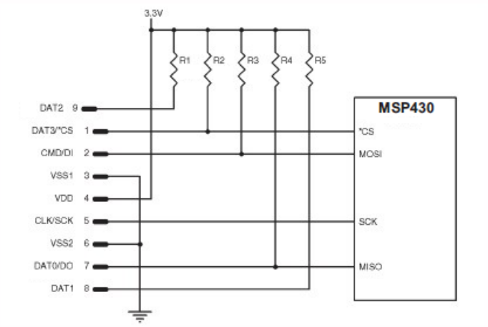
External Storage
MSP430 only has 16KB of flash memory.
Decided to use SD/MMC Card
Unable to get MSP430 to read from SD card
Alternate solution - repeat a few periods of each signal
Notes:
Jeff
Since the MSP430 we are using only has up to 16KB of flash memory and 512 bytes of RAM, we knew we needed external storage since there’s more than 300 data points per second for each signal. We attempted to use an SD card and would store about 30 seconds of data for each signal. In testing, we were never able to get the microcontroller to read the data from the card, just write to the card, but that’s not necessary for our project. So what we ended up doing is saving a couple periods of the signal into the flash memory of the MSP430 and just repeat that signal over and over again.

Slide 14
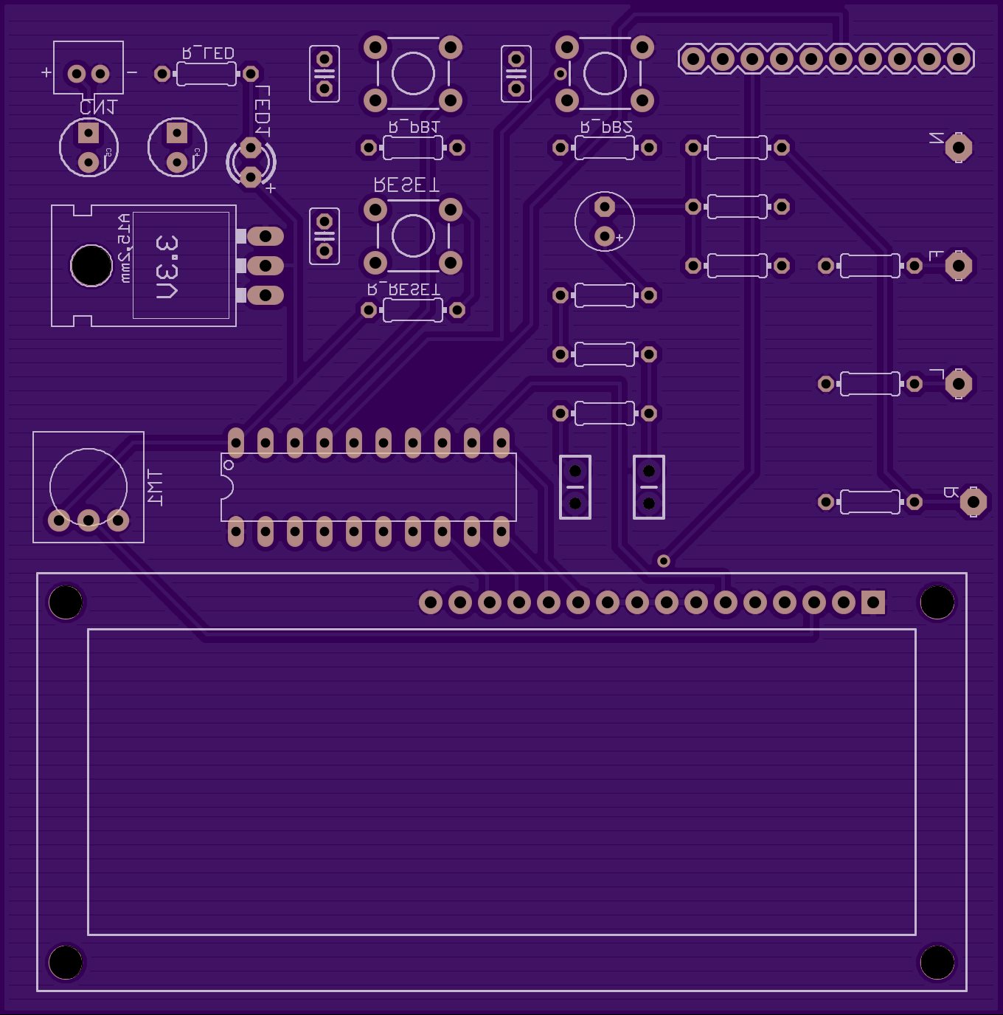
Heart Rate Simulator PCB Layout

Slide 15
Analog-Front Design
Instrumentation Amplifier
Low pass filter
High pass filter
Notch filter
Gain Amplifier
Notes:
Jonathan; The analog-front captures the electrical charges emitted through the skin during every heartbeat. We are designing a 3 electrode system. Typically medical grade ecg systems use 12 electrodes which allows you to view the ecg signal from multiple perspectives. The design of the analog front end is made from a few stages; the instrumentation amplifier which is the input, a low pass filter, a high pass filter, notch filter, and a gain amplifier.

Slide 16
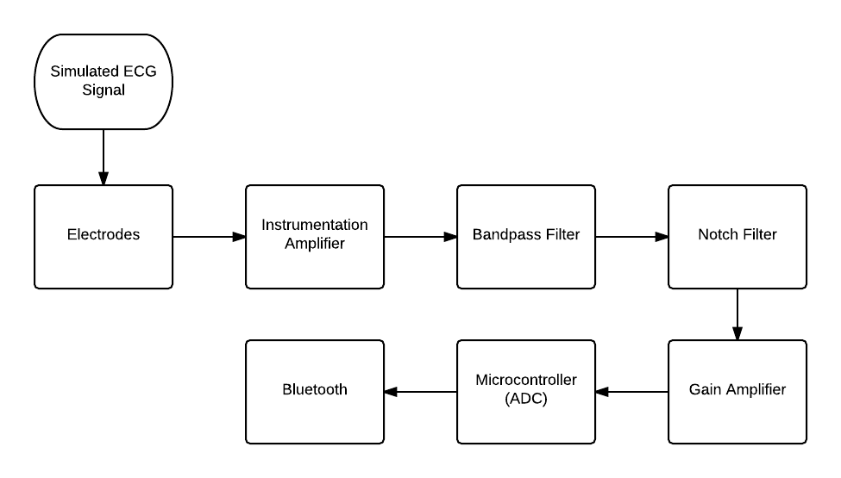
Block Diagram
Analog Front End Circuit
Notes:
Jonathan

Slide 17
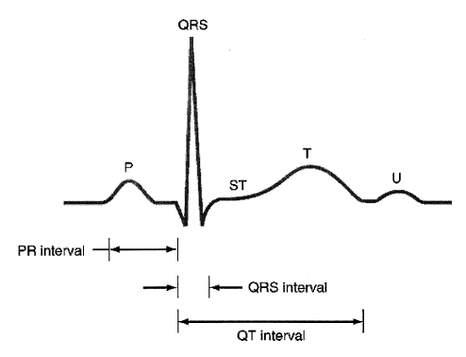
ECG Signal
Notes:
Jay A typical ECG signal consists of a P wave, a QRS complex, a T wave, and a U wave. They can be viewed as a time-varying voltage source. When we measure the ECG signal, we place electrodes at multiple places on the body surface across a pair of electrodes. Between a pair of electrodes we called it a lead. A different lead views the heart from different angles. For this project, we used a 3-lead ECG system.

Slide 18
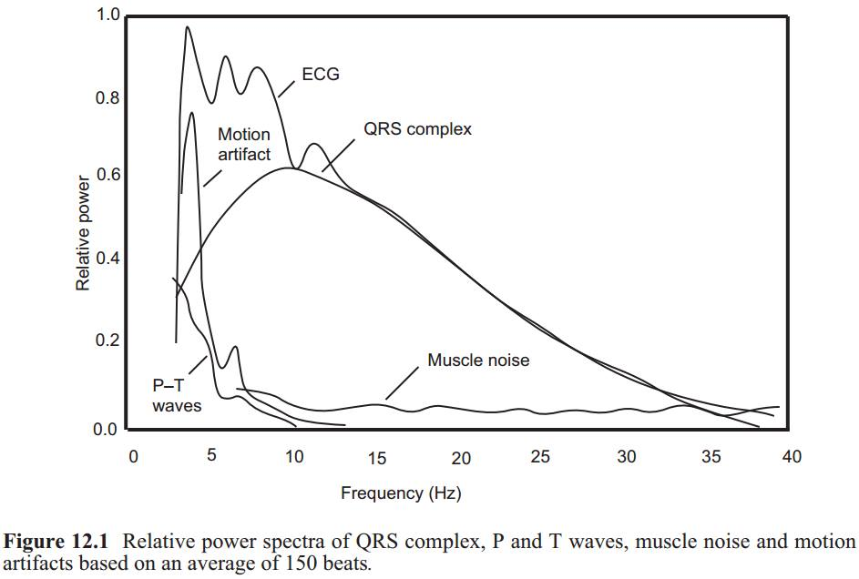
ECG signal Spectrum
Notes:
Jay
This is a power spectra of ECG signal, muscle noise and motion artifact based on an average of 150 beats. We used a bandpass filter passes frequencies within 0.05 Hz to 40 Hz. Unfortunately, the signal and noise may share the same frequency range such as the muscle noise and drift in DC offsets due to patient movement. A muscle potential across a human’s biceps should yield approximately 10 mV, whereas the ECG should be approximately 1 mV.

Slide 19
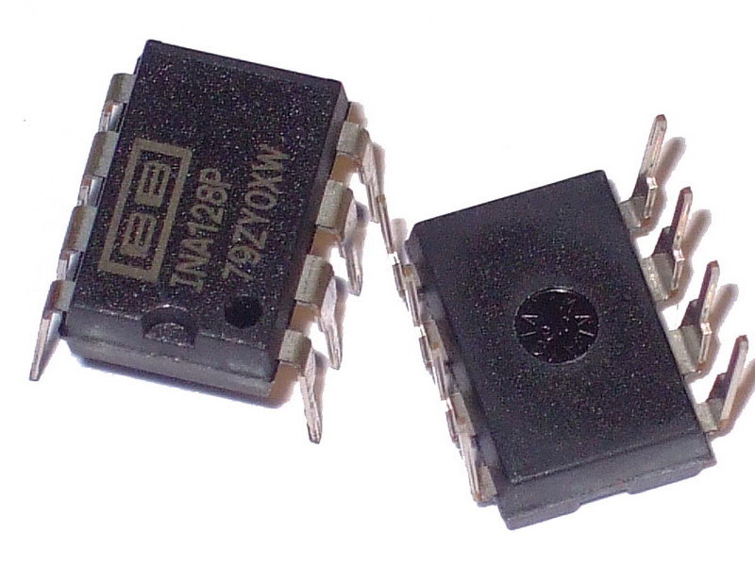
Stage 1- Instrumentation Amplifier
Common-mode noise: Radiations from Power, DC offset, muscle noise
The amplification circuitry provide a CMRR of better than 60dB.
Notes:
Jay
Therefore we used instrumentation amplifier to remove such noises. Also, when we measure the ECG by connecting two electrodes on the right and left hand. A 60 Hz magnetic field could be pickup by the lead wires. The ECG signal detected by the sensor on the electrodes would be accompanied by a large AC common-mode component up to 1.5 V and muscle noise. Therefore, a very high CMRR is very essential for Instrumentation Amplifier. The part we choose is INA128. It has high CMR, about 120 dB at the gain of 100. It is available in 8-pin plastic DIP which it is good for testing on the breadboard.

Slide 20
Stage 2- Low Pass Filter
Cut-off frequency is set to 150 Hz
The low pass filter cut-off frequency range allows us to view the complete spectrum contained within the ECG signal.
The filter was designed using Sallen-Key topology. It is a 4th order cascaded filter.
Op amp chosen is a TL084CN which offers low noise, high CMR, low power.
Notes:
Jonathan bandwidth, gain, importance of low pass filter to our project

Slide 21
Stage 3- High Pass Filter
Cut-off frequency is set to 0.05 Hz
The high pass filter limits DC wandering caused by electrical activity in the body.
The combination of the lowpass and highpass filter creates a bandwidth from 0.05 Hz - 150 Hz. Referred to as diagnostic mode. This allows us to view more detailed segments of the ECG signal.
Monitor mode has a bandwidth from 1 Hz to 40 Hz. Typically, used for quick ECG analysis.
Notes:
Jonathan bandwidth, gain, importance of high pass filter to our project
Bullet 1: Currently we are using a 0.1 Hz cutoff frequency in our design. After doing more research we found that we should be using 0.05 Hz as the cut-off frequency. This will allow us to capture the ST segment of the ECG signal. Using this cutoff frequency for the high pass filter along with using the 150 Hz cutoff frequency from the low pass filter is called diagnostic mode. The other mode that we could have chosen is monitor mode where the cut off frequency for the high pass filter is set at 0.5 Hz or 1 Hz and the low pass filter is set to 40 Hz. So in diagnostic mode you get a better resolution of the signal compared to monitor mode. Right now we are only building the diagnostic mode filter but if we get that filter working properly we may consider building the monitor mode filter and you will be able to select between the different modes.

Slide 22
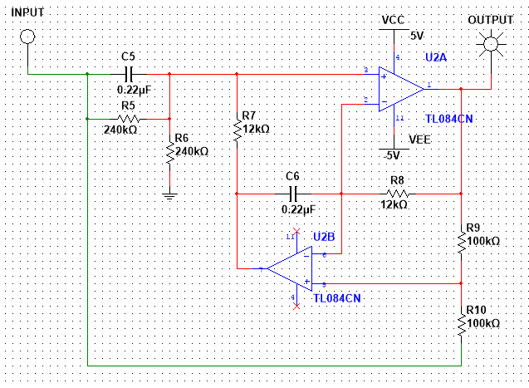
Stage 4- Notch Filter
Notes:
Jay
This is the Notch filter circuit we design to filtered out the 60Hz power interference.

Slide 23
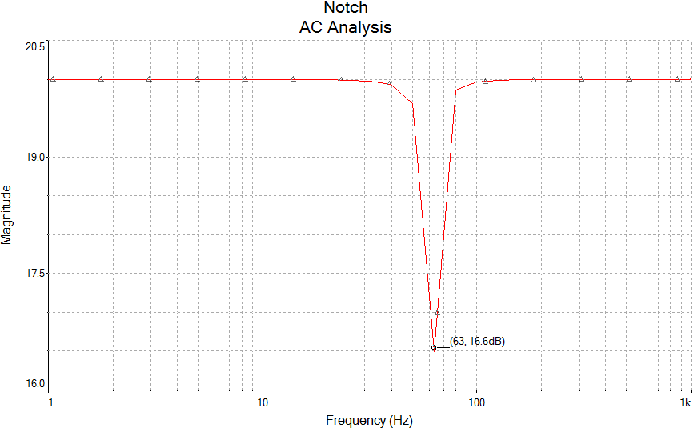
Notch Filter Frequency Response
Notes:
Jay
Unfortunately, in our design we only have a 1st order Notch filter. It gave us about 3dB loss at frequency of 63Hz. The power interference is still too large to eliminated. In the end, we added a digital filter to filter out all the extra noises.

Slide 24
Stage 5- Unity Gain Amplifier
Total Gain of circuit ~4000.
The final output of the Analog front is between 0 to 5V.
Non-Inverting terminal of op-amp has a DC offset of 1.5 volts to boost up the signal in the range of 0 to 5V.
Inverting terminal takes in the input of the notch filter.
The output of the op-amp has a diode to block negative voltage values.
Notes:
Jonathan
In order to make the ECG signal viewable, we amplified the ECG signal to approximately 1V Peak which required the total gain of 1000. In addition to that, the ADC we are using is only capable of taking any analog signal between 0 to 5V. We built a summing amplifier that gave the desired signal offset which boost up the signal to positive range only.

Slide 25
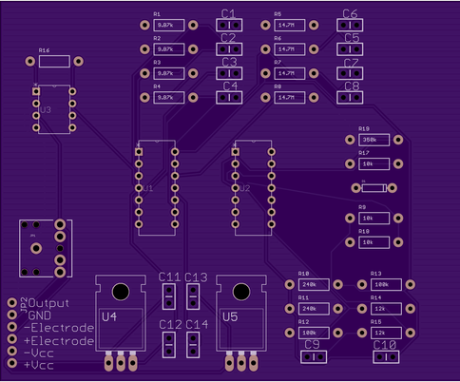
PCB Layout- Analog Front
Notes:
Jonathan

Slide 26
Analog to Digital Converter
The signal should be sampled at a rate of not less than 120 Hz.
The signal should be amplified to be almost 1 V.
We decided to use Built-in ADC from Atmel ATtiny85
Notes:
Jay
The ADC should not be sampled at a rate less than 120 Hz. We decided to use the built in ADC from the Atmel ATtiny85 because it is programmable and the price is cheaper than a normal ADC chip. The Atmel ATtiny85 takes about 100 microseconds to read an analog input, so the maximum reading rate is about 10,000 times a second.

Slide 27
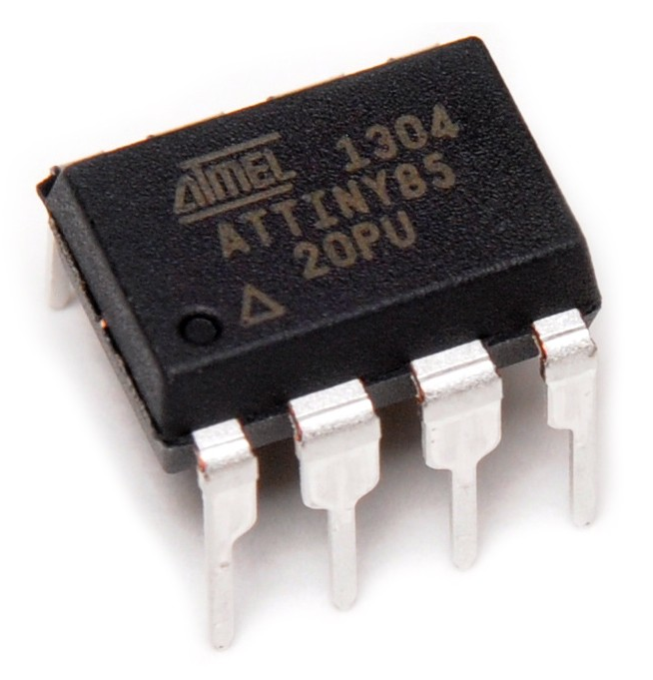
Atmel ATtiny85
2.7 - 5.5 V operating voltage
10-bit ADC
8 MHz internal clock speed
8k bytes programmable memory
8-pin PDIP
6 bi-directional I/O ports
Arduino IDE
Notes:
Jay
Atmel ATtiny85 is the microcontroller we used to transmit the ECG signal to mobile app. The reasons we choose this microcontroller chip is because we can apply 5V to turn on. The instrumentation amplifier and op amps we used in analog front can also be turned on by applying 5V. Meaning this simplified the power management of our circuit. ATtiny85 is capable of doing serial communication, and also 6 I/O ports will be sufficient for our usage. The ADC takes 1 port and Bluetooth transmission takes 2 ports. We programmed this chip with Arduino UNO board as in system programming. The coding language is the same as the Arduino UNO board. At first, we used the UNO board as prototype. (However, I burned ATtiny chip on Sunday afternoon. I got the chip last night but I don’t want to risk my chance and modify what’s already working. So today, we will be doing the demo with Arduino UNO.)

Slide 28
Digital Filter - Median Filter
If the exact value is [2 80 6 3],
y[1] = Median[2 2 80] = 2,
y[2] = Median[2 80 6] = 6,
y[3] = Median[80 6 3] = 6,
y[4] = Median[6 3 3] = 3.
so the final output is [2 6 6 3].
Arduino Library credit to Jeroen Doggen
Notes:
Jay
We added the Digital Filter with Arduino coding. The filter we used is median filter. We used a window size of three with one entry immediately preceding and following each entry because there is no entry preceding the first value, the first value is repeated, as with the last value.

Slide 29
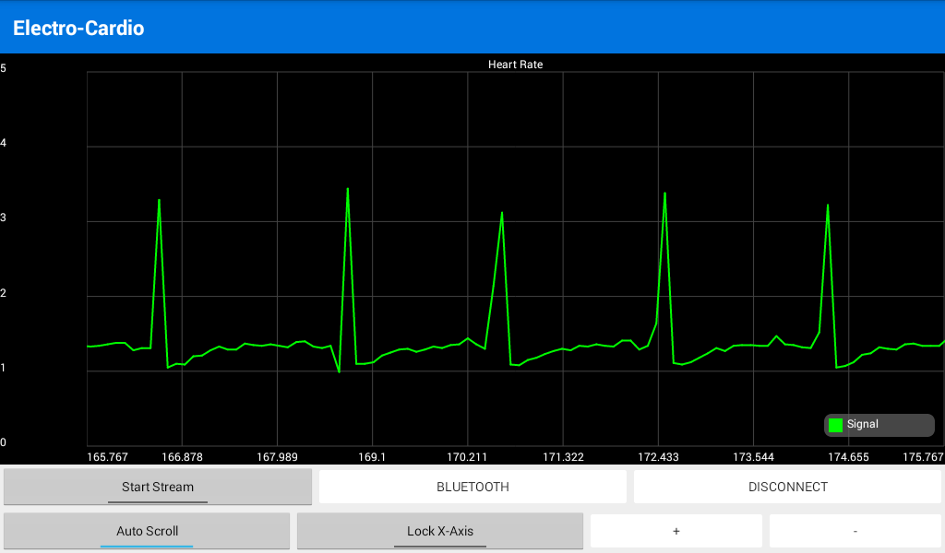
Filtering Signal
After Median Filter
Before Median Filter
Notes:
Jay
This is our filtered signal after running through the median filter. The signal did get a lot better. But the downside of using this filter is that sometime it filtered out the peak value if there’s only one sample at the peak. This filter can only be used to clean up noisy signals by suppressing small (fast) signals changes while passing bigger (slow) signal changes.

Slide 30
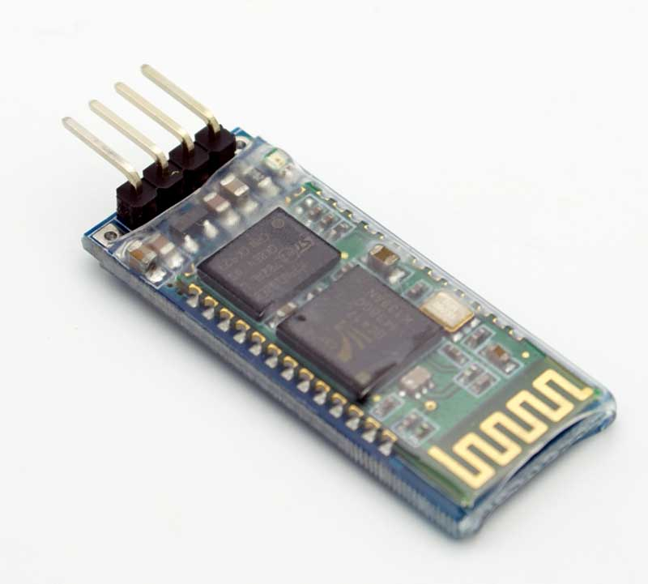
Bluetooth Specification
Product Model | HC-06 with Backboard (Only support Bluetooth V2.1)
Size (cm) | 3.5*1.5
Power | 5VDC 50 mA
Service | Slave only
Price | $10.67 for 2
Notes:
Jay
The Bluetooth module we are using is the HC-06. It is programmable. We can modify the baud rate, name of the device to the serial monitor using ATCommands, and it is compatible with an Arduino device. It only supports Bluetooth Version 2.1. We used the bluetooth with backboard for prototype. It allows us to both send and receive the TTL data via Bluetooth to the mobile device.

Slide 31
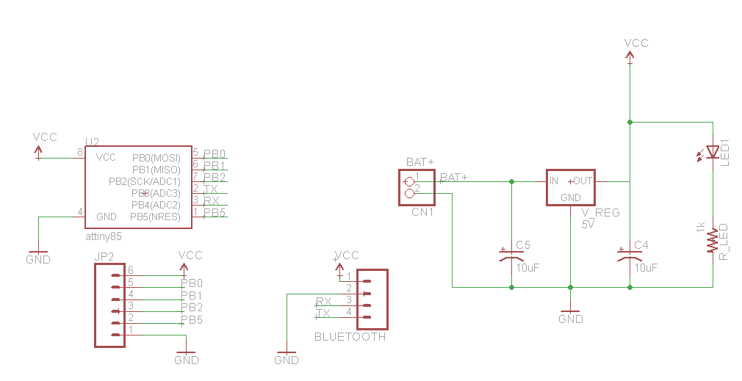
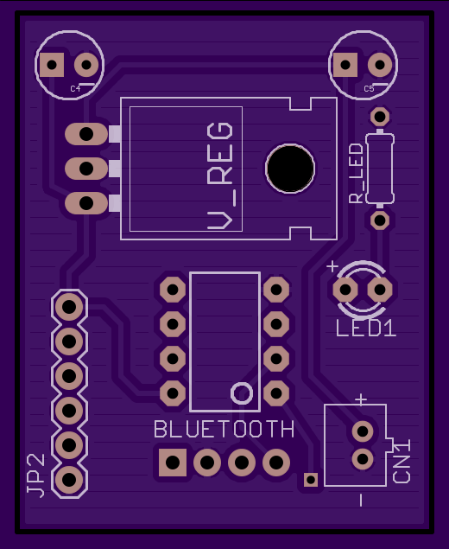
Microcontroller and Bluetooth PCB Schematics and Layout
Notes:
Jay
This is the PCB for attiny and bluetooth.

Slide 32
Power Management
PART | VOLTAGE | CURRENT (max)
MSP430 | 3.3 V | 0.4 mA
16x2 LCD | 3.3 V | 2.5 mA
Atmel ATtiny | 5V | 5 mA
HC-06 Bluetooth | 5 V | 50 mA
INA128P | 5 V | .7 mA
TL084CN | 5 V | 1.4 mA
Notes:
Jonathan

Slide 33
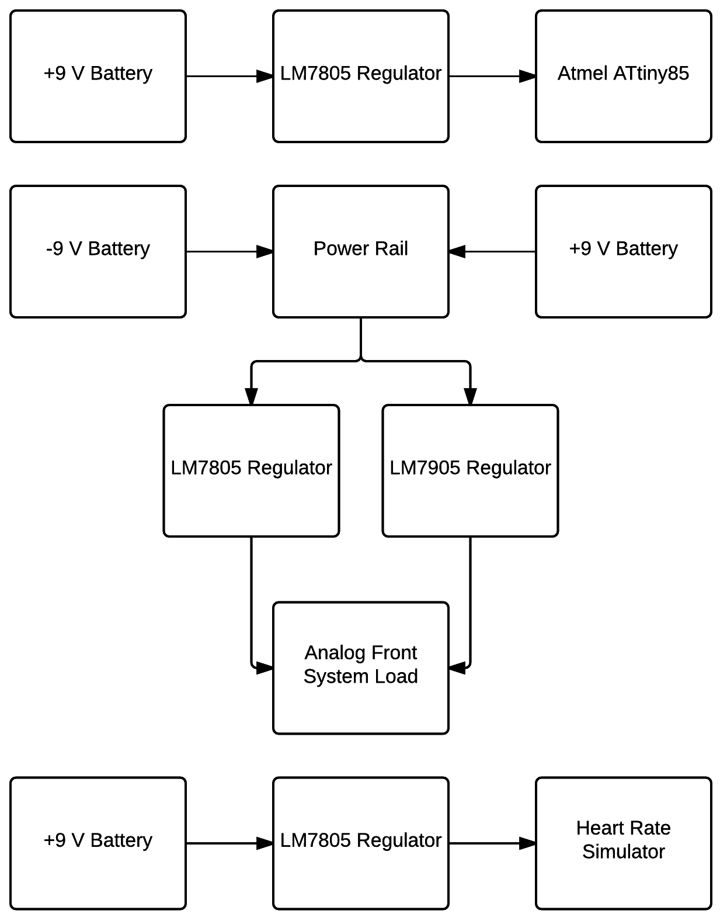
Power Block Diagram
Notes:
Jonathan Add block diagram for power for each subsystem

Slide 34
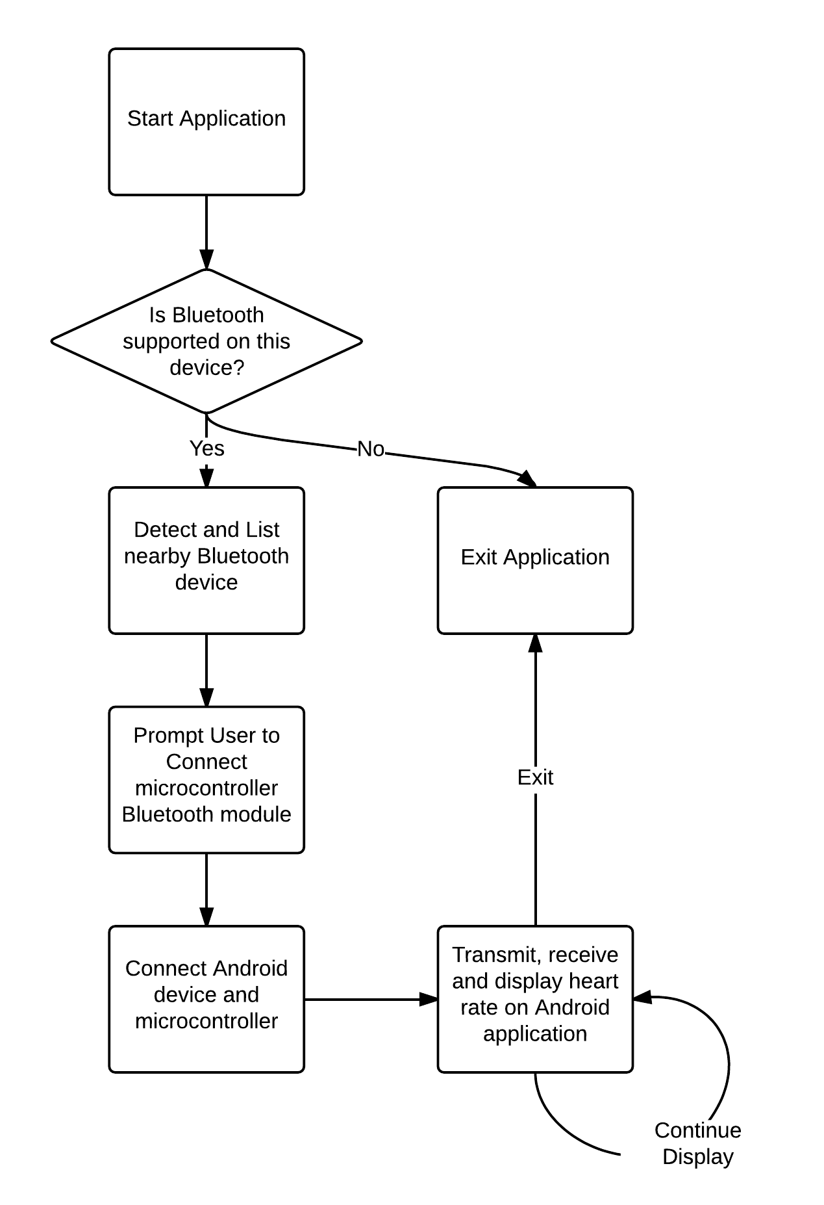
Mobile
App
Block
Diagram
Notes:
Michael
Pretty straight forward, when the application is started, if the users Android device does not support Bluetooth, the application will just exit.
If Bluetooth is supported, the user can scan for nearby Bluetooth devices, which will be displayed in a list.
The user can then tap the Bluetooth module to pair the devices. Once they are paired, the user can navigate to the HeartRateActivity screen, which will receive heart rate data and display it.

Slide 35
GUI
Notes:
Michael
This is the Main Activity Screen, the Bluetooth On/Off buttons are self explanatory.
Scan For Devices button will look for nearby Bluetooth devices which will populate the list view where users can tap on the device to pair them up. It will prompt the user for a pin code.
Paired Devices button will display a list of devices that are currently paired with the Android.

Slide 36
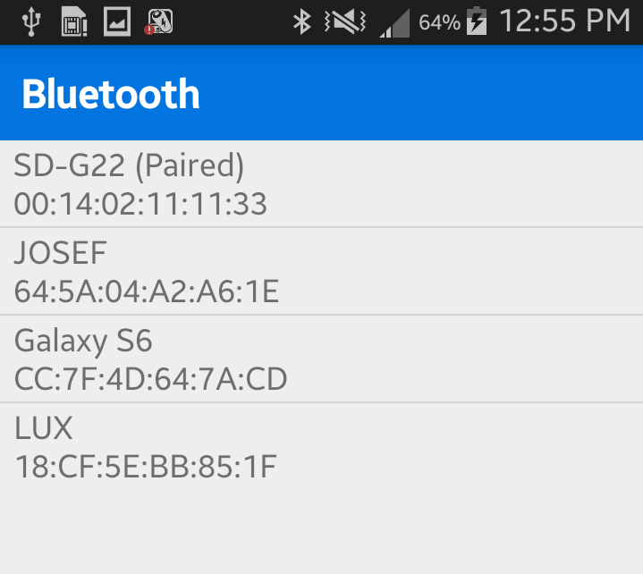
GUI
Notes:
Michael
This is the Main Activity Screen, the Bluetooth On/Off buttons are self explanatory.
Scan For Devices button will look for nearby Bluetooth devices which will populate the list view where users can tap on the device to pair them up. It will prompt the user for a pin code.
Paired Devices button will display a list of devices that are currently paired with the Android.

Slide 37
Sending/Receiving Data
Needed to create a separate thread (ConnectThread) for connecting Bluetooth module and Android device
ConnectThread takes in BluetoothDevice and creates a BluetoothSocket
We need yet another thread (ConnectedThread) to utilize InputStream & OutputStream for reading in data
Handler handles the processing of data and displays heart rate signal
Notes:
Michael
We need a separate thread for the Android and the Bluetooth module to pair up because forming a connection can block a thread for a significant amount of time. This thread takes in a BluetoothDevice as a parameter and uses it to create a BluetoothSocket. The main User Interface thread should never be blocked.
The socket is what Bluetooth uses to transfer data between devices.
Transferring data is time-intensive and can block the thread, so that needs to be in another thread as well. This thread requires a BluetoothSocket as a parameter and creates an InputStream and OutputStream.
The InputStream allows us to receive data in real time and process it to display the heartrate

Slide 38
GraphView
GraphView - Open source graph plotting for Android
We imported the GraphView library and used it to display a graph in real time.
Credit to: Jonas Gehring
www.android-graphview.org
Notes:
Micheal

Slide 39
Expenses
Item | Quantity | Price ($) | Vendor
INA128 | 2 | 13.00 | ebay
Green 16 pin LCD | 1 | 4.95 | ebay
TL084CN | 10 | 3.99 | ebay
ATTiny85 | 2 | 3.99 | ebay
Electrodes | 50 | 7.89 | ebay
SD Card Breakout | Many | 9.95 | Sparkfun
Sensor Cable | 1 | 4.95 | Sparkfun
Miscellaneous | Many | 20.00
Bluetooth Module | 2 | 10.76
MSP430 Launchpad | 1 | FREE
PCBs | 9 | 136.00 | OSH Park
Total |  | 215.48
Notes:
Michael

Slide 40
Actual Product Price
ITEM | PRICE
Electrodes | $7.89
MCU | $5.98
INA128 | $13.00
TL084 | $6.31
LCD display | $6.90
Miscellaneous | $25.00
PCB | $68.70
Total | $110.65
Already have Android device for testing
Notes:
Michael

Slide 41
Group Responsibilities
 | Jeffrey Frye | Jonathan Gibson | Michael Sun | Jay Wang
Heart Rate Simulator | ■ |  |  | □
ECG Sensor |  | □ |  | ■
Power System |  | ■
Bluetooth Communication |  |  | ■ | □
Android Application | □ |  | ■
■ - Main Responsibility
□ - Partial Responsibility
Notes:
Michael
Grey are partial responsibilities

Slide 42
Questions

